Slide 1


NATIVE ADVERTISING,
POWERED BY DATA.
Confidential and proprietary. Copyright © 2016 Xaxis Inc. All rights reserved. Distribution without permission is prohibited.

Slide 2

AGENDA
COMPANY
FORMATS
TECHNOLOGY
INVENTORY
SERVICE

Slide 3

MILESTONES
2008
INTRODUCTION OF AD
SPONSORED REVENUE MODEL
2010
ACQUIRED BY WPP, INTERNATIONALIZATION
2015-2016
STARTING OFF AS A SAAS PROVIDER OF RECOMMENDATION
SERVICES FOR PUBLISHERS
2009
DEVELOPMENT OF VARIOUS SPECIAL FORMATS
2014
STRATEGIC ALLIANCE WITH XAXIS, INTERNATIONAL EXPANSION

Slide 4
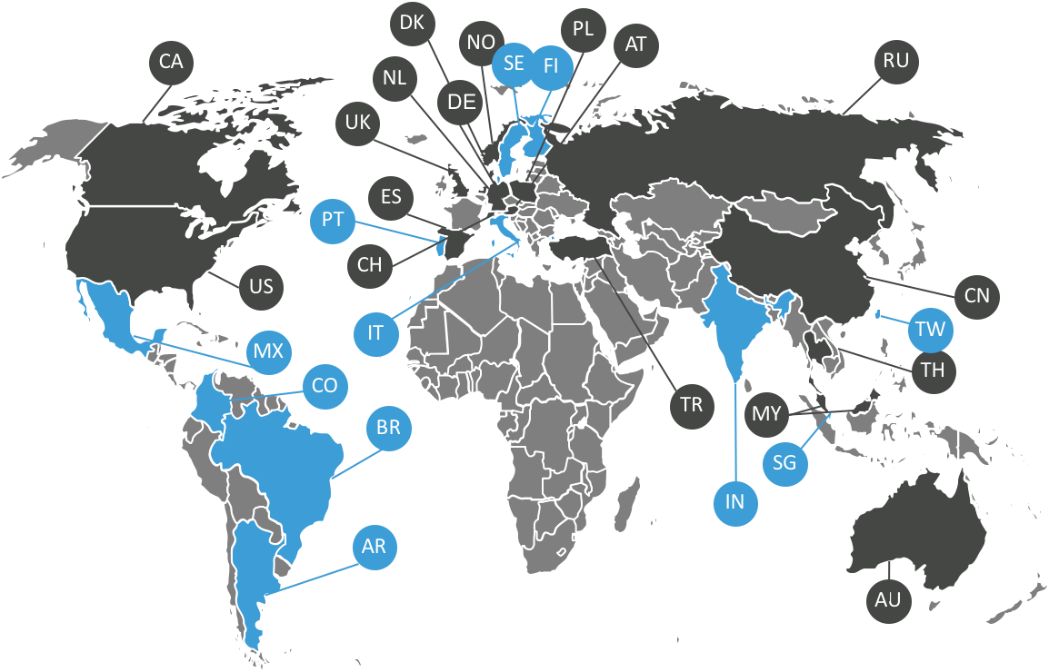
WHEN NATIVE GOES GLOBAL
PLISTA TODAY
Cooperation with Xaxis
17 International Markets
14 Offices & Partner Offices
180 FTEs at plista HQ in Berlin
40 FTEs working for plista in
Global (partner) offices
BY THE END OF 2017
25+ new markets
20+ offices & partner offices
ESTABLISHED MARKETS
UPCOMING MARKET ENTRIES

Slide 5
AGENDA
COMPANY
FORMATS
TECHNOLOGY
INVENTORY
SERVICE

Slide 6
What is
NATIVE Advertising?

Slide 7
NATIVE Advertising?
Is a combination of FORM and RELEVANCE

Slide 8
Ad and content recommendations, matching the look & feel of the surrounding content, seamlessly fitting into the user experience they are embedded in.
Ad and content recommendations, personalized, calculated in real-time, delivered to users by a data-driven targeting engine.
PLACEMENT-CENTRIC
USER-CENTRIC
FORM
RELEVANCE

Slide 9
What is the COMBINATION of FORM and RELEVANCE?

Slide 10
Realizes goals along the sales funnel by maintaining maximum user relevance.
AWARENESS
ENGAGEMENT
PLACEMENT-CENTRIC
ACTION
USER-CENTRIC
FORM
RELEVANCE

Slide 11
What is
Native Advertising with plista ?

Slide 12
Engaging Native
Ad FORMATS

Slide 13

Engaging
native formats
I. FORM
THE MISSION
plista develops data-driven recommendation technologies and effective native ad solutions,
to deliver non-intrusive content and advertisement recommendations to each individual user.
Unique data-driven targeting technology
Premium publisher inventory
III. INVENTORY
II. RELEVANCE

Slide 14
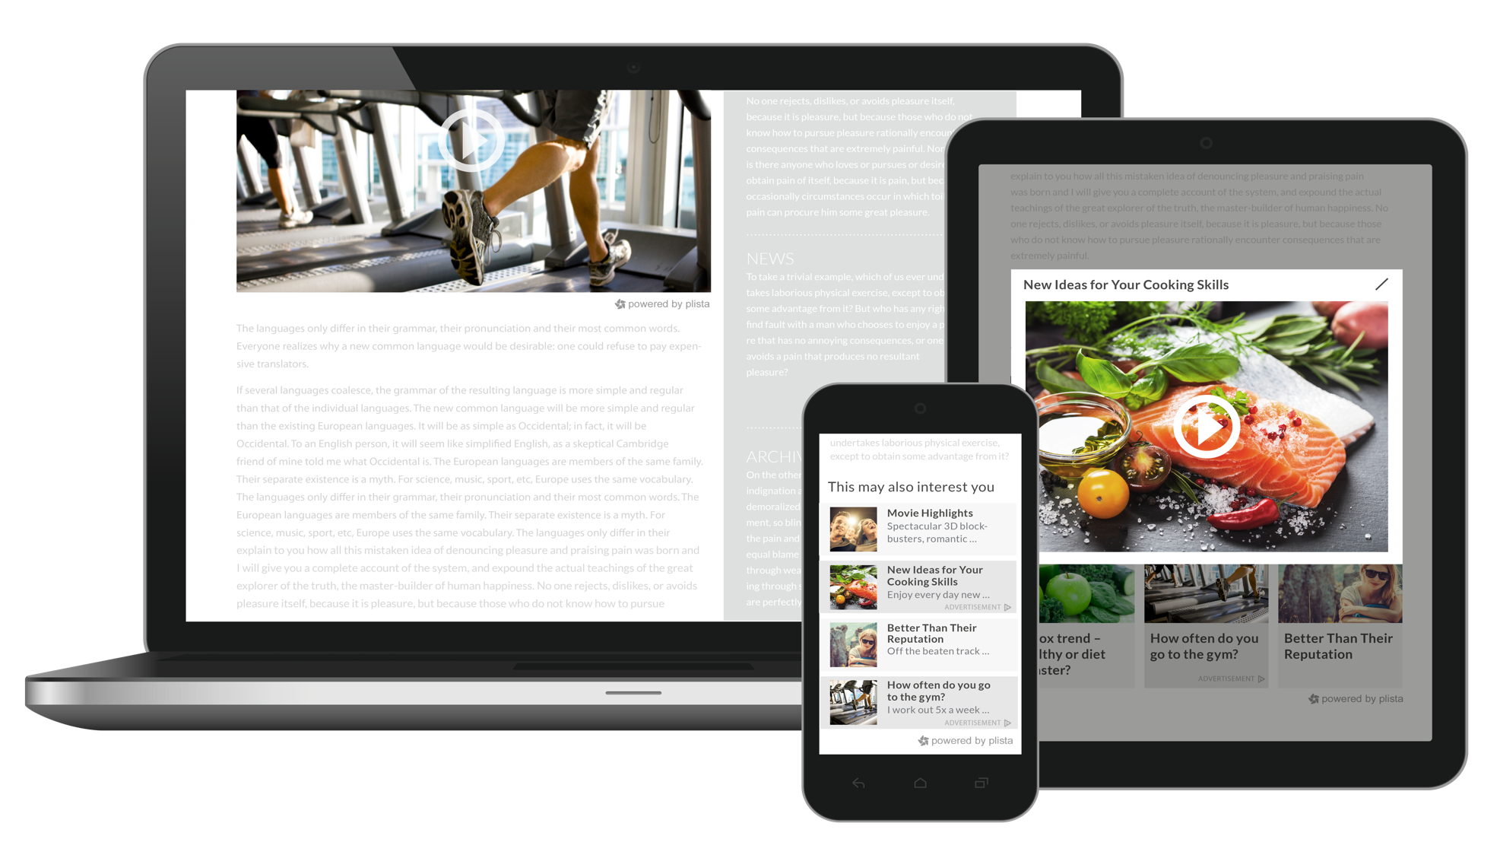

Slide 15





ENGAGING NATIVE FORMATS ACROSS THE SALES FUNNEL
Recommendation Formats
InFeed Formats
Awareness
Native Video Ads
Native Outstream Ads
Native
Content
Distribution
Focus on
Engagement – the perfect combination of awareness and action
Native Recommendation
Ads
Native
InFeed Ads
Every second user thinks that native content creates a more engaging and positive appeal for brands.*
Action
*Source: Native Advertising Research 2015 by ForwardAd Group

Slide 16
FORMAT OVERVIEW
Recommendation Formats
InFeed Formats
Awareness
Native Video Ads
Native OutstreamAds
Native
Content
Distribution
Focus on
Engagement – the perfect combination of awareness and action
Native Recommendation
Ads
Native
InFeed Ads
Every second user thinks that native content creates a more engaging and positive appeal for brands.*
Action
*Source: Native Advertising Research 2015 by ForwardAd Group

Slide 17
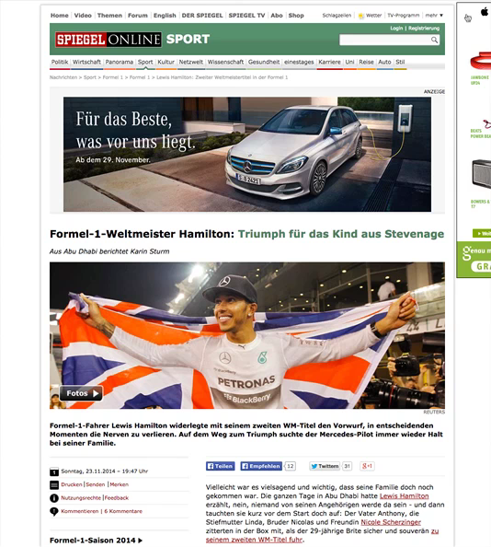
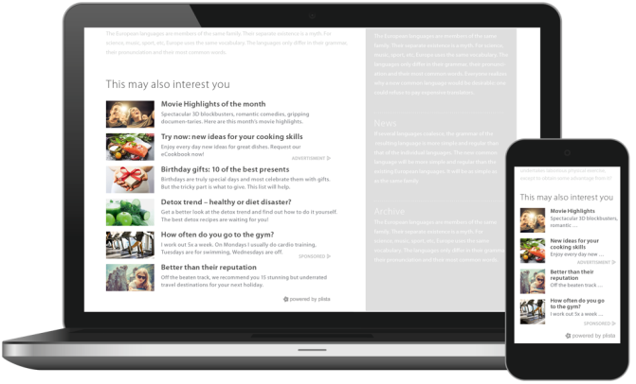
NATIVE RECOMMENDATION ADS
Engaging native format, perfectly suited for performance campaigns with great reach:
Performance optimization for specific marketing goals (leads, conversions, downloads)
Wide range of targeting options
Pricing on CPC basis
Awareness
Engagement
Action

Slide 18
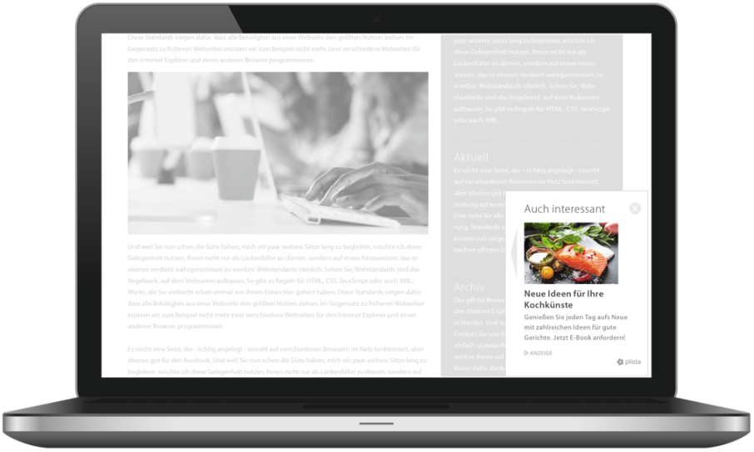
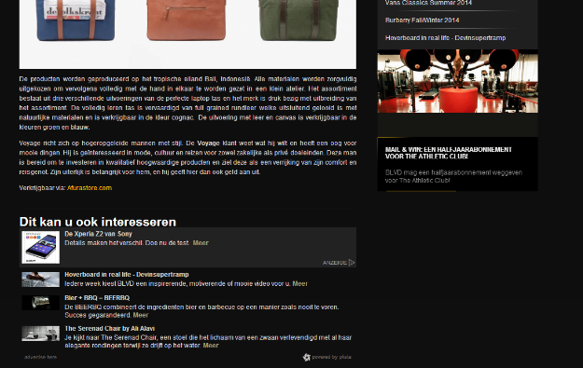


NATIVE RECOMMENDATION ADS CASE STUDY
Awareness
Engagement
19% lower bounce rate…
2 times higher session time on
landing page…
… compared to the average of display ad placements.*
Action
*Source: SONY XperiaZ2 Case Study by plista NL

Slide 19
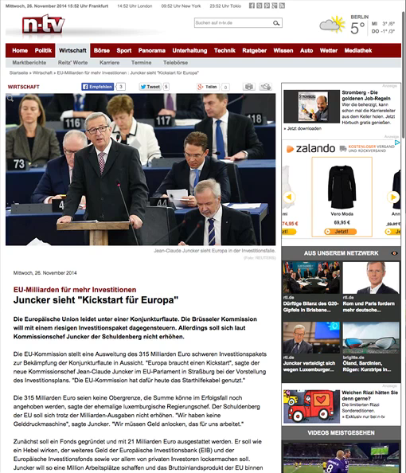
NATIVE RECOMMENDATION ADS
Sponsored content recommendations to increase brand awareness, brand trust & customer loyalty.
Tailor-made to distribute content from paid, owned and earned media
High CTR through contextual and behavioral targeting
Pricing on CPC basis
Awareness
Engagement
Action

Slide 20
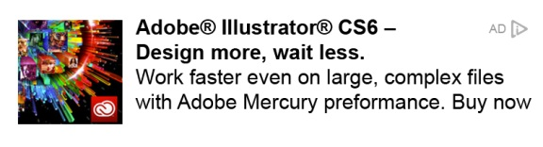
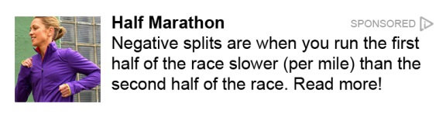

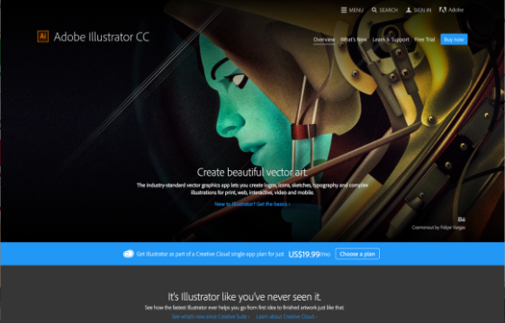
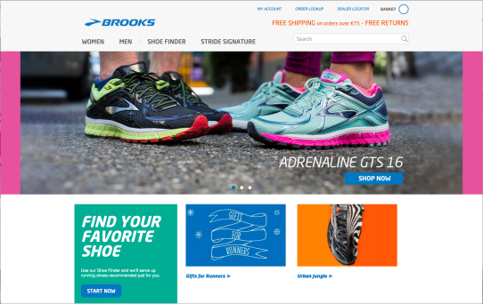
RECOMMENDATION ADS VS. CONTENT DISTRIBUTION
RECOMMENDATION FORMATS| IN-FEED WIDGETS | SPECIALS
Native RecommendationAds
Native Content Distribution
For performance-oriented campaigns
Focus on sales: leads, conversions, downloads etc.
Call-to-action
Labeled as „Ad“, „Advertising“ etc.
For branding-oriented content marketing campaigns
Focus on brand awareness & brand trust, customer loyalty
Educational, informational or entertaining content – with relevance & added value for user
Labeled as „Sponsored“ etc.

Slide 21
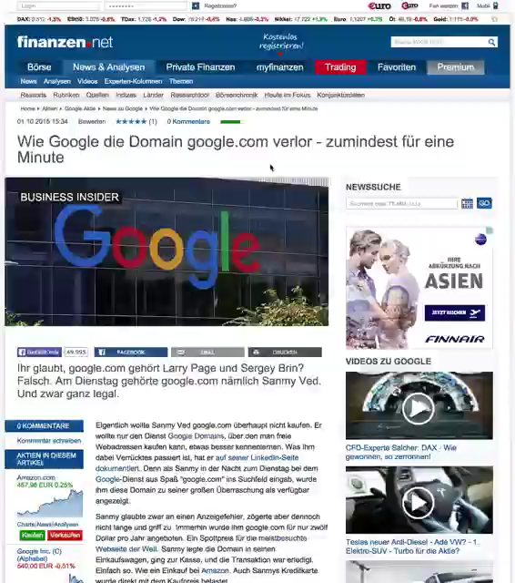
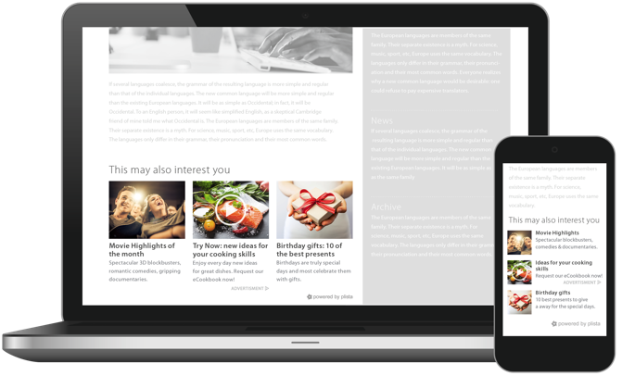
NATIVE VIDEO ADS
User-initiated format: video expands out of a plista recommendation ad on mouseover or by click.
Creates strong user engagement – ideal for product launches, branding etc.
Optional combination of branding (video) and performance (action box) for optimum ROI
Pricing on CPE/CPC basis
Awareness
Engagement
Action

Slide 22
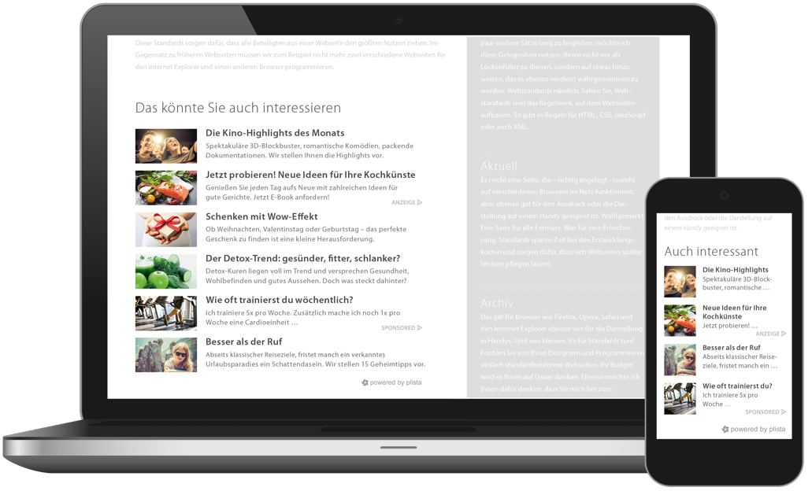
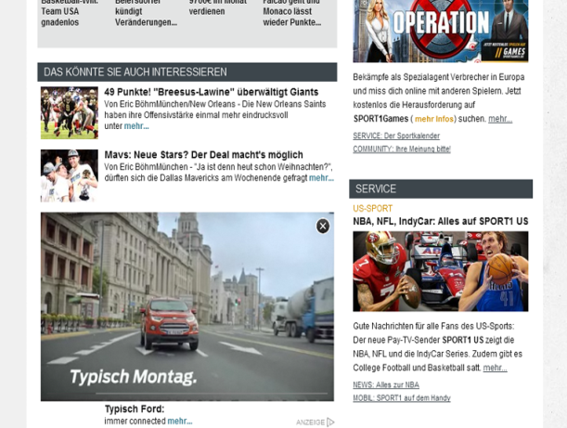
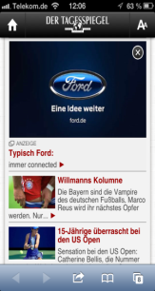


NATIVE RECOMMENDATION ADS CASE STUDY
Awareness
Increase in brand awareness by 41%*
Image Uplift up to 114%*
Increase in intention to buy by 45%*
Engagement
Action
*Source: Interrogare Research 2014

Slide 23
FORMAT OVERVIEW
Recommendation Formats
InFeed Formats
Awareness
Native VideoAds
Native Outstream Ads
Native
Content
Distribution
Native Recommendation
Ads
Native
InFeed Ads
Engagement
Action

Slide 24
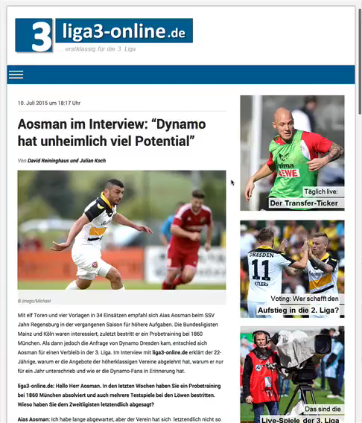
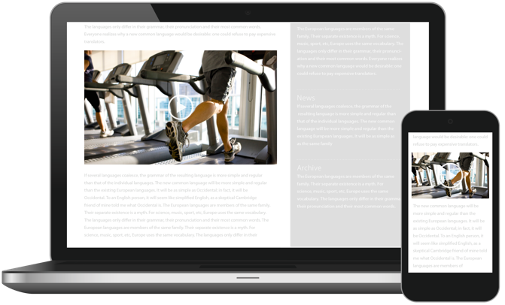
NATIVE OUTSTREAM ADS
High-impact video format for maximum brand awareness.
High view rates: video expands between the paragraphs of an article when users scroll down
Positive brand perception thanks to non-disruptive format
Pricing on CPV or CPE basis
Awareness
Engagement
Action

Slide 25
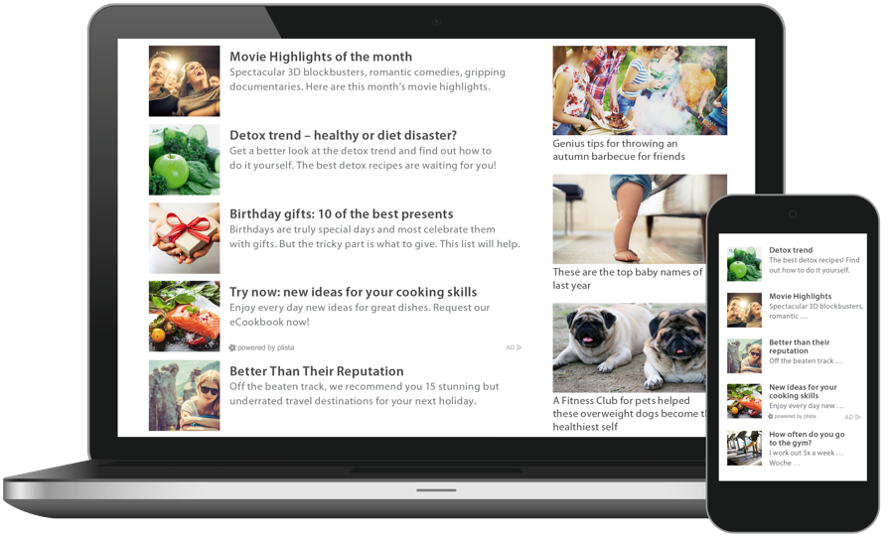
NATIVE INFEED ADS
Recommendations placed between editorial teasers on feed-based websites.
Tailor-made to fit the user experience of article feeds
Focused, conscious reading and higher credibility thanks to native placement within publishers’ feed
Works both for content and ads
Pricing on CPC basis
Awareness
Engagement
Action

Slide 26
AGENDA
COMPANY
FORMATS
TECHNOLOGY
INVENTORY
SERVICE

Slide 27


RELEVANCE POWERED BY DATA
Publisher Data
User Data
Technical Data
1st party data is collected and enriched
Global Optimization by plista Ensemble Algorithm & Xaxis Turbine
plista Ensemble Algorithm
Xaxis Turbine
Collaborative Filtering,
Behavioral & Semantic Targeting
Precise Targeting
Data-driven,
user-individual delivery

Slide 28
AGENDA
COMPANY
FORMATS
TECHNOLOGY
INVENTORY
SERVICE

Slide 29








DIRECT PREMIUM PUBLISHER RELATIONS
Our Global Premium Publishers
plista‘s native solutions cover all publisher needs ...
Stickiness
Monetization
Traffic
Sustainable increase in user visit duration and depth of visit
Optimal content monetization
by creating new ad inventory
Targeted navigation of users, on & cross-site
... and deliver outstanding results:
Native Ads Revenue Uplift of 69%*
Increase in vCTR by 48%*
*Source: plista Case Study 2015, Article Widget vs. Ads Only

Slide 30




COMPETITIVE POSITIONING: SUPPLY SIDE
ADVERTISING
STANDARD
NATIVE
SUPPLY
CONTENT
DEMAND

Slide 31
AGENDA
COMPANY
FORMATS
TECHNOLOGY
INVENTORY
SERVICE

Slide 32
360° SERVICE
1. BRIEFING
2. SETUP & DELIVERY
Dedicated, personal contact
Analysis of individual needs and professional consultation
Comprehensive support: instructions/how-to-guides, case studies, market research, white papers etc.
Free support and consultation for selecting ideal ad creatives and targeting criteria
Identification of relevant KPIs suitable to the campaign goals
Upon request, optimization of landing pages.
3. REPORTING & OPTIMIZATION
Automated interim-reportings and personalized monitoring dashboard
Continuing campaign optimization by our campaign management
Joint evaluation of the success of the campaign

Slide 33
THANK YOU!
Confidential and proprietary. Copyright © 2016 Xaxis Incorporation. All rights reserved. Distribution without permission is prohibited.

Slide 34
APPENDIX
Confidential and proprietary. Copyright © 2016 Xaxis Incorporation. All rights reserved. Distribution without permission is prohibited.

Slide 35



COMPLEMENTARY FUNNEL: PLISTA, XAXIS & LIGHT REACTION
1. Awareness / Reach
2. Interaction / Engagement
3. Action / Conversion
For GroupM Agencies Only
Non-native IAB Inventory
Scalable, data-driven audience buying
In-stream video ads
Guaranteed outcome
Mobile & cross-channel
DEMAND FOR
Native Inventory
Engagement through premium editorial placements
Content Distribution, in-page video
Proprietary and 3rd party native inventory
Branding
Combining each brand’s individual strengths for maximum user engagement

